Slide 1
Exception Handling

Slide 2
Exception Handling In Java
When an exception occurs in the program, the program execution is terminated. As this is an abrupt termination, the system generates a message and displays it. The message generated by the system may be cryptic like some codes or unreadable.
Thus the normal user should understand why the program stopped its execution abruptly, he/she should know the reason. The system generated messages as a result of exception may not be helpful. In Java, we can handle the exception and provide meaningful messages to the user about the issue.
This handling of exception, commonly known as “Exception handling” is one of the salient features of Java programming.

Slide 3
Reasons For The Exception To Occur
We can have various reasons due to which exceptions can occur. If its an exception related to input, then the reason may be that the input data is incorrect or unreadable.
If we get an exception for file I/O then it is quite possible that the files we are dealing with do not exist. At some other time, there may be errors like network issues, printer not available or functioning, etc.
In a program, apart from exceptions, we also get errors. Thus, to handle the exceptions effectively, we need to be aware of the differences between error and an exception.
An error indicates a more serious issue with the application and the application should not attempt to catch it. On the contrary, the exception is a condition that any reasonable application will try to catch.
Thus an error in the application is more severe and the applications would crash when they encounter an error. Exceptions on the other hand occur in code and can be handled by the programmer by providing corrective actions.

Slide 4
What Is Exception Handling?
The Exception Handling in Java is a mechanism using which the normal flow of the application is maintained. To do this, we employ a powerful mechanism to handle runtime errors or exceptions in a program.
A sequence of code that is used to handle the exception is called the “Exception handler”. An exception handler interrogates the context at the point when the exception occurred. This means that it reads the variable values that were in scope while the exception occurred and then restores the Java program to continue with normal flow.

Slide 5
Benefits Of Exception Handling
The major benefit of Exception handling is that it maintains the normal flow of the application despite the occurrence of an exception. When an exception occurs, the program usually terminates abruptly.
Having an exception handler in a program will not cause the program to terminate abruptly. Instead, an exception handler makes sure that all the statements in the program are executed normally and the program flow doesn’t break abruptly.

Slide 6
Exception Hierarchy In Java
The class java.lang.Throwable (descendent of Object class) is the root class of Java Exception.
The classes Exception and Error are derived from this class.
Exception class is the base class for all the other exceptions.

Slide 7
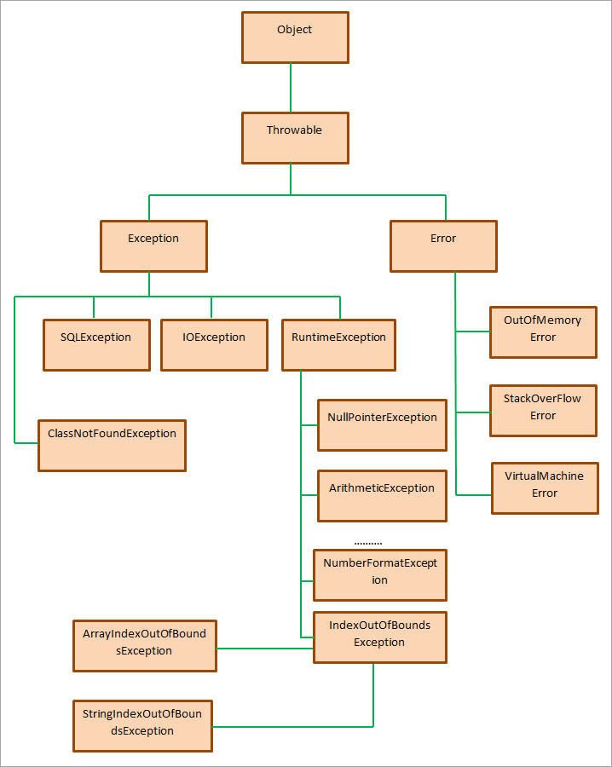

Slide 8
Exception Class In Java
As seen in the hierarchy diagram, class Throwable has two direct subclasses i.e. Exception and Error. Exceptions arising from an external source are described in the Exception class.
The Exception class declares the constructors as the same as Throwable class and invoking of each constructor also invokes its Throwable counterpart. Exception class does not declare its methods, it inherits Throwable class methods.

Slide 9
The Constructors that the Exception class uses
Constructor | Description
public Exception() | A default constructor that constructs a new exception with the message as null.
public Exception(String message) | Constructor to construct a new exception with the given message. In this case, the cause is not initialized, and a subsequent call to Throwable.initCause (java.lang.Throwable) may be used to initialize the cause.
public Exception(String message,Throwable cause) | Constructs a new exception using a given message and cause.
public Exception(Throwable cause) | Constructs a new exception with the given cause and a message given by (cause==null ? null: cause.toString()) (which typically contains the class and detail message of cause).
protected Exception(String message, Throwable cause, boolean enableSuppression, boolean writableStackTrace) | Constructs a new exception with the given message, cause, suppression (enabled or disabled), and the writable stack trace (enabled or disabled).

Slide 10
Methods
Method Prototype | Description
public String getMessage() | Get a detailed message about the exception that occurred.
public Throwable getCause() | Get the cause of the exception represented by a throwable object
public String toString() | Concatenates the name of the class with the result of getMessage() and returns the resultant string.
public void printStackTrace() | Prints the result of toString() and the contents of stack trace to the error output stream, System.err.
public StackTraceElement [] getStackTrace() | Get each element in the stack trace in the form of an array.
public Throwable fillInStackTrace() | Fill the stack trace with the current stack trace.

Slide 11
Types Of Exceptions In Java
Checked Exception
Unchecked Exception
Error

Slide 12
Checked Exception
Some exceptions are checked at the compile-time when the code is compiled. These are “Checked exceptions”.
The Java program throws a compilation error when it finds that the code inside a program is error-prone.
We can take care of the compilation errors thrown by checked exception by handling the exceptions by either enclosing the code in a try-catch block or using the throws keyword.
In the Exception hierarchy, the class directly inheriting Throwable class like IOException, ClassNotFoundException, etc. are all checked exception

Slide 13
Unchecked Exception
Unchecked exceptions are the exceptions that are checked at run time. Hence despite exceptions, a compilation of programs will be successful.
Most of the unchecked exceptions are thrown owing to the bad data used in the program.
The classes that inherit “RuntimeException” are unchecked exceptions. Exceptions like ArrayIndexOutofBounds Exception, ArithmeticException, NullPOinterException, etc. are examples of unchecked exceptions.
Examples of Unchecked Exception:
ArrayIndexOutOfBoundsException
NullPointerException
IllegalArgumentException
NumberFormatException
Apart from the above two exceptions, there are few more Checked exceptions including:
SQLException
InvocationTargetExecption

Slide 14
Error
Error is usually an irreversible and irrecoverable situation in a program and when an error occurs, the programs crash. Some of the examples of errors in a program are OutOfMemoryError, AssertionError, and VirtualMachineError, etc.
Error class inherits from the Throwable class. Error describes a situation that cannot be handled and results in a program crashing.

Slide 15
OutOfMemory error
We know that all the objects in Java are allocated using the new operator and are stored on the heap. When the heap goes out of memory, the Java Virtual Machine (JVM) cannot allocate the object. At the same time, the garbage collector cannot free any memory. This situation gives rise to the OutOfMemory error.
"exception in thread \"main\" java.lang.outofmemoryerror: java heap space“
The presence of OutOfMemoryError in a program means either too much data is being processed or the objects are being held for too long. Sometimes, it can also be a third-party library that uses up memory.

Slide 16
Causes Of OutOfMemoryError
Java Heap Space
If an application has too many finalizers, then the class objects having the Finalize method are not reclaimed by garbage collector immediately but are queued up for finalization at a later time. Sometimes, the finalization cannot keep up with time, and heap memory is filled up resulting in OutOfMemoryError.
Another reason for OutOfMemoryError is that the heap size specified may be insufficient for the application.

Slide 17
List Of Exceptions In Java
ArithmeticException: Arithmetic abnormalities like divide by zero results in ArithmeticException.
#2) ArrayIndexOutOfBoundsException: ArrayIndexOutOfBoundsException is thrown when an array element is accessed using an illegal index. The index used is either beyond the size of the array or is negative.
#3) ClassNotFoundException: If the class definition is not found then the ClassNotFoundException is raised.
#4) FileNotFoundException: FileNotFoundException is given when the file does not exist or does not open.
#5) IOException: IOException is thrown when the input-output operation fails or is interrupted.
#6) InterruptedException: Whenever a thread is doing processing or sleeping or waiting, then it is interrupted by throwing InterruptedException.
#7) NoSuchFieldException: If a class does not contain a specified field or variable, then it throws NoSuchFieldException.
#8) NoSuchMethodException: When the method being accessed is not found, then NoSuchMethodException is raised.
#9) NullPointerException: NullPointerException is raised when a null object is referred. This is the most important and most common exception in Java.

Slide 18
#10) NumberFormatException: This exception is raised when a method could not convert a string into a numeric format.
#11) RuntimeException: Any exception that occurs at runtime is a RuntimeException.
#12) StringIndexOutOfBoundsException: The StringIndexOutOfBoundsException is thrown by String class and indicates that the index is beyond the size of the String object or is negative.
#13) EOFException: EOFException is a part of the java.io package and is thrown when the end of file is reached and the file is being read.
#14) IllegalArgumentException: IllegalArgumentException is thrown when illegal or invalid arguments are passed to the method
#15) InputMismatchException: InputMismatchException is thrown when the input read does not match a pattern specified. For example, if the program expects integer and reads a float, then the InputMismatchException is raised.
#16) NoSuchElementException: NoSuchElementException is thrown when the next element accessed does not exist.

Slide 19
Flow control in try catch finally in Java
Control flow in try-catch clause OR try-catch-finally clause
Case 1: Exception occurs in try block and handled in catch block
Case 2: Exception occurs in try-block is not handled in catch block
Case 3: Exception doesn’t occur in try-block
try-finally clause
Case 1: Exception occurs in try block
Case 2: Exception doesn’t occur in try-block

Slide 20
1. Exception occurs in try block and handled in catch block:
If a statement in try block raised an exception, then the rest of the try block doesn’t execute and control passes to the corresponding catch block.
After executing the catch block, the control will be transferred to finally block(if present) and then the rest program will be executed.
Case1: Control flow in try-catch:
Case2:Control flow in try-catch-finally clause :

Slide 21
2. Exception occurred in try-block is not handled in catch block:
In this case, default handling mechanism is followed. If finally block is present, it will be executed followed by default handling mechanism.
1. try-catch clause :
2. try-catch-finally clause :

Slide 22
3. Exception doesn’t occur in try-block:
In this case catch block never runs as they are only meant to be run when an exception occurs. finally block(if present) will be executed followed by rest of the program.
try-catch clause :
try-catch-finally clause

Slide 23
Control flow in try-finally
In this case, no matter whether an exception occur in try-block or not, finally will always be executed. But control flow will depend on whether exception has occurred in try block or not.
1. Exception raised: If an exception has occurred in try block then control flow will be finally block followed by default exception handling mechanism.
2. Exception not raised: If an exception does not occur in try block then control flow will be finally block followed by rest of the program

Slide 24
Throw
The throw keyword in Java is used to explicitly throw an exception from a method or any block of code.
We can throw either checked or unchecked exception.
The throw keyword is mainly used to throw custom exceptions.
throw Instance
Example:
throw new ArithmeticException("/ by zero");
But this exception i.e, Instance must be of type Throwable or a subclass of Throwable.

Slide 25
throws
throws is a keyword in Java which is used in the signature of method to indicate that this method might throw one of the listed type exceptions.
The caller to these methods has to handle the exception using a try-catch block.
type method_name(parameters) throws exception_list
exception_list is a comma separated list of all the
exceptions which a method might throw.
We can use throws keyword to delegate the responsibility of exception handling to the caller (It may be a method or JVM) then caller method is responsible to handle that exception.

Slide 26
throws
throws keyword is required only for checked exception and usage of throws keyword for unchecked exception is meaningless.
throws keyword is required only to convince compiler and usage of throws keyword does not prevent abnormal termination of program.
By the help of throws keyword we can provide information to the caller of the method about the exception.

Slide 27
User-defined Custom Exception in Java
An exception is an issue (run time error) that occurred during the execution of a program.
When an exception occurred the program gets terminated abruptly and, the code past the line that generated the exception never gets executed.
Java provides us the facility to create our own exceptions which are basically derived classes of Exception.
Creating our own Exception is known as a custom exception or user-defined exception.
Basically, Java custom exceptions are used to customize the exception according to user needs.
User-Defined Exception or custom exception is creating your own exception class and throwing that exception using the ‘throw’ keyword.
For example, MyException in the below code extends the Exception class.

Slide 28
Why use custom exceptions?
Following are a few of the reasons to use custom exceptions:
To catch and provide specific treatment to a subset of existing Java exceptions.
Business logic exceptions: These are the exceptions related to business logic and workflow. It is useful for the application users or the developers to understand the exact problem.
In order to create a custom exception, we need to extend the Exception class that belongs to java.lang package.
Example: We pass the string to the constructor of the superclass- Exception which is obtained using the “getMessage()” function on the object created.

